Slide 1
Inheritance-I
Dr. Zahid Halim

Slide 2
Introduction [1]
Probably most powerful feature of OOP
Concept similar to inheritance in real life
New classes are created from existing classes
New classes absorb all features of existing classes including their data and functions. Also enhance them by adding their own new features in form of new data members and new member functions

Slide 3
Quiz
Develop class Polynomial. The internal representation of a Polynomial is an array of terms. Each term contains a coefficient and an exponent. The term
2x⁴
has the coefficient 2 and the exponent 4
Develop a class containing proper constructor. The class should also provide the following overloaded operator capability:
Overload the addition operator (+) to add two Polynomials.

Slide 4
Introduction [2]
Existing classes are called base classes
New classes are called derived classes
Objects of derived classes are more specialized as compared to objects of their base classes
Inheritance provides us a mechanism of software reusability which is one of the most important principles of software engineering
  Tested and debugged classes are used to create new classes
  Distribution of code becomes more easy, libraries can be distributed more easily to software developer’s community

Slide 5
Inheriting Data and Functions
All data members and member functions of base class are inherited to derived class
Constructors, destructors and = operator are NOT inherited

Slide 6
Some definitions in class hierarchy
Direct base class
  Inherited explicitly (one level up hierarchy)
Indirect base class
  Inherited two or more levels up hierarchy
Single inheritance
  Inherits from one base class
Multiple inheritance
  Inheritance from multiple classes

Slide 7
Types of Inheritance
Public (we will use in initial examples, most commonly used type of inheritance)
Private
Protected
We will see all of them later in detail

Slide 8
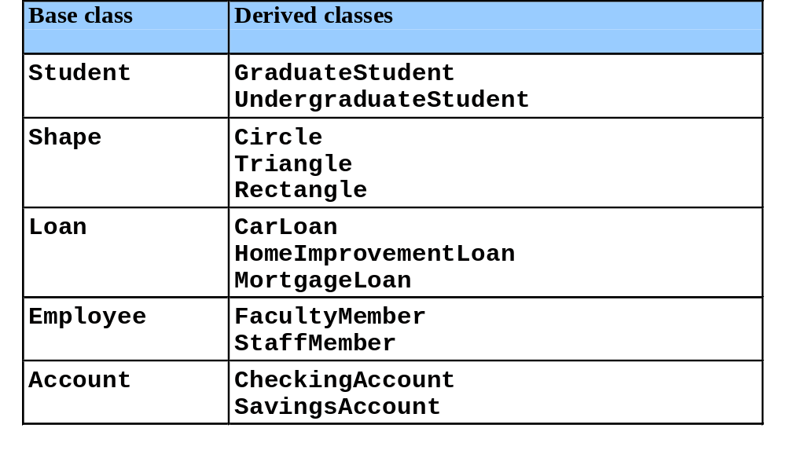
Inheritance Examples

Slide 9
Inheritance Hierarchy
  Inheritance relationships: tree-like hierarchy structure
  Each class becomes
    Base class
      Supply data/behaviors to other classes
    OR
    Derived class
      Inherit data/behaviors from other classes

Slide 10
Another example: University’s community member’s hierarchy
CommunityMember
Employee
Student
Alumnus
Single inheritance
Faculty
Staff
Single inheritance
Administrator
Teacher
Single inheritance
AdministratorTeacher
Multiple inheritance

Slide 11
Another example: Shapes class hierarchy
Shape
TwoDimensionalShape
ThreeDimensionalShape
Circle
Square
Triangle
Sphere
Cube
Tetrahedron

Slide 12
Public Inheritance Example
Creating circle class inherited from point class
  Point
    x-y coordinate pair
  Circle
    x-y coordinate pair
    Radius

Slide 13
Base class and derived class relationship
  Example: Point/circle inheritance hierarchy
    Point
      x-y coordinate pair
    Circle
      x-y coordinate pair
      Radius

Slide 14
Example
class Point
{
int x,y;
//constructors and other functions
};
class Point3D : public Point
{
int z;
//constructors and other functions
};

Slide 15
Specialization Vs Generalization
Specialization
  Top down hierarchy
Generalization
  Bottom up hierarchy
If car is subclass of vehicle class then
  Vehicle is more general but car is a special type of vehicle

Slide 16
Is-A vs Has-A relationship
Has-A relationship is composition type of relationship (Whole-Part relationship)
  Car has an engine
Is-A relationship: also called association
  Car is vehicle
  Student is person
Implementation:
  Composition: making member
  Association: using inheritance

Slide 17
Protected access specifier
We studied two type of access specifiers till now
  private: only accessible inside the class
  public: accessible everywhere, inside the class and as well out side the class
There is another type of access specifier
  protected: grant access to only class and inherited class
  Base class public and protected members are inherited to subclass with original member access

Slide 18
Friend functions and Inheritance
Friend functions are not inherited
If class A is derived from class B and fun is friend function of B
fun does not become a friend of A automatically by inheritance, we must make fun as friend of A explicitly if desirable

Slide 19
Is there any problem in following code?
class Point
{
int x,y;
//constructors and other functions
};
class Point3D : public Point
{
int z;
public:
Point3D() { x=y=z=0; }
};
Can not access private members
of base class in derived class
x and y should be protected

Slide 20
Example: Circle class
class Point
{
protected:
int x,y;
public:
Point(int,int);
};
Point::Point(int a,int b)
{
x=a;
y=b;
}

Slide 21
class Circle : public Point
{
double radius;
public:
Circle(int,int,double);
void display(void);
};
void Circle::display(void)
{
cout<<"center point = [" <<x<<","<<y<<"]";
cout<<" and radius = "<<radius;
}
Circle::Circle(int a,int b,double c)
{
x=a;
y=b;
radius = c;
}

Slide 22
void main(void)
{
Circle c(3,4,5);
c.display();
}

Slide 23
Rewriting point and circle classes
class Point
{
protected:
int x,y;
public:
Point(int,int);
void display() ;
};
Point::Point(int a,int b)
{
x=a;
y=b;
}
void Point::display()
{
cout<<"point = [" <<x<<","<<y<<"]";
}

Slide 24
class Circle : public Point
{
double radius;
public:
Circle(int,int,double);
void display();
};
Circle::Circle(int a,int b,double c):Point(a,b) {
radius = c;
}
void Circle::display() {
Point::display();
cout<<" and radius = "<<radius;
}

Slide 25
void main(void)
{
Circle c(3,4,5);
c.display();
}

Slide 26
Three-Level Inheritance Hierarchy
Three level point/circle/cylinder hierarchy
  Point
    x-y coordinate pair
  Circle
    x-y coordinate pair
    Radius
  Cylinder
    x-y coordinate pair
    Radius
    Height

Slide 27
class Point
{
protected:
int x,y;
public:
Point(int,int);
void display();
};
Point::Point(int a,int b)
{
x=a;
y=b;
}
void Point::display()
{
cout<<"point = [" <<x<<","<<y<<"]";
}

Slide 28
class Circle : public Point
{
protected:
double radius;
public:
Circle(int,int,double);
void display();
double GetArea();
};
Circle::Circle(int a,int b,double c):Point(a,b) {
radius = c;
}
void Circle::display() {
Point::display();
cout<<" radius = "<<radius;
}
double Circle::GetArea() {
return 3.14 * radius * radius;
}

Slide 29
class Cylinder:public Circle
{
double height;
public:
Cylinder(int,int,double,double);
void display();
double GetVolume();
};
Cylinder::Cylinder(int a,int b,double r,double h):Circle(a,b,r) , height(h){
}
double Cylinder::GetVolume() {
return GetArea() * height;
}
void Cylinder::display() {
Circle::display();
cout<<" height = "<<height;
}

Slide 30
void main(void)
{
Cylinder c(3,4,2.5,3.7);
c.display();
cout<<"\nVolume of cylinder is : “ <<setprecision(4)<<c.GetVolume();
}
Output:
point=[3,4] radius = 2.5 height = 3.7
Volume of cylinder is : 72.61

Slide 31
Order of execution of Constructors/Destructors
Instantiating derived-class object
  Chain of constructor calls
    Derived-class constructor invokes base class constructor
      Implicitly or explicitly
    Base of inheritance hierarchy
      Last constructor called in chain
      First constructor body to finish executing
      Example: Point/Circle/Cylinder hierarchy
        Point constructor called last
        Point constructor body finishes execution first

Slide 32
Order of execution of Constructors/Destructors
Destroying derived-class object
  Chain of destructor calls
    Reverse order of constructor chain
    Destructor of derived-class called first
    Destructor of next base class up hierarchy next
      Continue up hierarchy until final base reached
        After final base-class destructor, object removed from memory

Slide 33
Example
class Point
{
protected:
int x,y;
public:
Point(int,int);
void display();
~Point() { cout<<"\nPoint Class Destructor\n"; }
};
Point::Point(int a,int b) {
cout<<"\nPoint Class Constructor\n";
x=a;
y=b;
}
void Point::display() {
cout<<"point = [" <<x<<","<<y<<"]";
}

Slide 34
class Circle : public Point
{
protected:
double radius;
public:
Circle(int,int,double);
void display();
~Circle() { cout<<"\nCircle Class Destructor\n"; }
};
Circle::Circle(int a,int b,double c):Point(a,b) {
cout<<"\nCircle Class Constructor\n";
radius = c;
}
void Circle::display() {
Point::display();
cout<<" radius = "<<radius;
}

Slide 35
class Cylinder:public Circle
{
double height;
public:
Cylinder(int,int,double,double);
void display();
double GetVolume();
~Cylinder() { cout<<"\nCylinder Class Destructor\n"; }
};
Cylinder::Cylinder(int a,int b,double r,double h):Circle(a,b,r) {
cout<<"\nCylinder Class Constructor\n";
height=h;
}
double Cylinder::GetVolume() {
return 3.14 * radius * radius * radius;
}
void Cylinder::display() {
Circle::display();
cout<<" height = "<<height;
}

Slide 36
void main(void)
{
Cylinder c(3,4,2.5,3.7);
}
Output:
Point Class Constructor
Circle Class Constructor
Cylinder Class Constructor
Cylinder Class Destructor
Circle Class Destructor
Point Class Destructor

Slide 37
Overriding
The function in the derived class with the same function (variable) name will override the functions (variables) in the base classes.
But you can still invoke or get the overrode functions(variables) with scope resolution operator ”::”.
We have used overriding in previous examples…
  display function of Point, Circle and Cylinder

Slide 38
Types of inheritance
public
private
protected

Slide 39
Public Inheritance
With public inheritance, public and protected members of the base class become respectively public and protected members of the derived class.

Slide 40
Protected Inheritance
Public and protected members of the base class become protected members of the derived class.

Slide 41
Private Inheritance
With private inheritance, public and protected members of the base class become private members of the derived class.

Slide 42
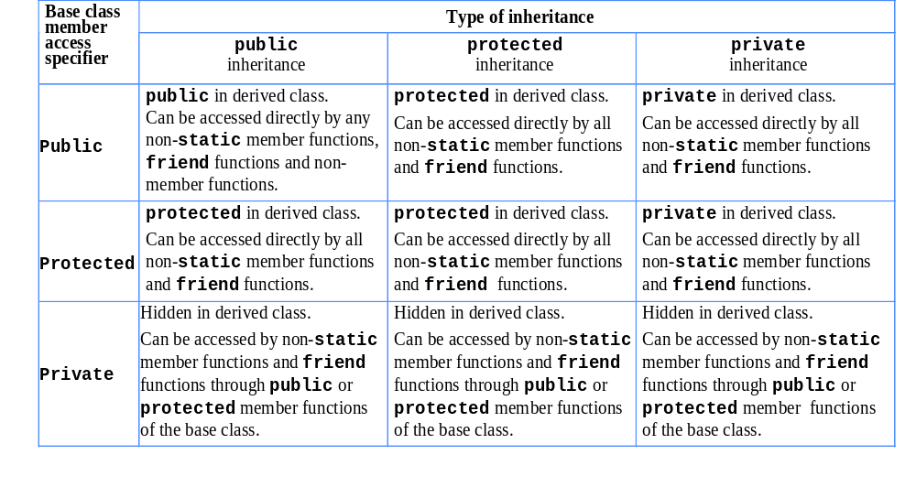
public, protected and private Inheritance

Slide 43
References
Book Code: A

Slide 44
Quiz
Develop class Polynomial. The internal representation of a Polynomial is an array of terms. Each term contains a coefficient and an exponent. The term
2x⁴
has the coefficient 2 and the exponent 4. Develop a complete class containing proper constructor and destructor functions. The class should also provide the following overloaded operator capabilities:
Overload the addition operator (+) to add two Polynomials.
Overload the subtraction operator (-) to subtract two Polynomials.

Slide 45
Inheritance-III
Dr. Zahid Halim

Slide 46
Multiple Inheritance
Employee
Student
Salaried
GraduateAssistant

Slide 47
What is Multiple Inheritance?
If class A inherits from more than one class, ie. A inherits from B1, B2, ..., Bn, we speak of multiple inheritance.
This may introduce naming conflicts in A if at least two of its superclasses define properties (data members or member functions) with the same name.

Slide 48
//simple example showing multiple inheritance
class base1 {
public:
void funbase1(void) { cout<<"funbase1"; }
};
class base2 {
public:
void funbase2(void) { cout<<"funbase2"; }
};
class derived:public base1, public base2 {
public:
void funderived(void) { cout<<"funderived";}
};
void main(void) {
derived der;
der.funbase1();
der.funbase2();
der.funderived();
}

Slide 49
//Example 2 (showing ambiguity because of multiple inheritance)
typedef unsigned long ulong;
class Student {
ulong id;
unsigned age;
public:
unsigned GetAge() const { return age; }
ulong GetId() const { return id; }
void SetAge( unsigned n ) { age = n; }
void SetId( ulong n ) { id=n; }
};
class Employee {
public:
unsigned GetAge() const { return age; }
void SetAge( unsigned n ) { age = n; }
void SetId( ulong n) { id=n; }
ulong GetId(void) const { return id; }
private:
unsigned age;
ulong id;
};

Slide 50
class Salaried :public Employee {
float salary;
public:
float GetSalary() const { return salary; }
void SetSalary( float s ) { salary=s; }
};
class GradAssistant :public Student, public Salaried {
public:
void Display() const;
};
void GradAssistant::Display() const {
cout<<GetId()<<","<<GetSalary()<<","<<GetAge(); //ambiguity
}
void main(void) {
GradAssistant ga;
ga.SetAge(20); //ambiguity
ga.SetId(15); //ambiguity
ga.Display(); //ambiguity inside display function
}
//program will not compile and will generate errors

Slide 51
What is the solution?
Call functions explicitly by specifying name of class and using scope resolution operator to remove ambiguity
  Direct solution: Student::SetAge() or Salaried::SetAge().
  Virtual inheritance

Slide 52
//Example 2 corrected
typedef unsigned long ulong;
class Student {
ulong id;
unsigned age;
public:
unsigned GetAge() const { return age; }
ulong GetId() const { return id; }
void SetAge( unsigned n ) { age = n; }
void SetId( ulong n ) { id=n; }
};
class Employee {
public:
unsigned GetAge() const { return age; }
void SetAge( unsigned n ) { age = n; }
void SetId( ulong n) { id=n; }
ulong GetId(void) const { return id; }
private:
unsigned age;
ulong id;
};

Slide 53
class Salaried :public Employee {
float salary;
public:
float GetSalary() const { return salary; }
void SetSalary( float s ) { salary=s; }
};
class GradAssistant :public Student, public Salaried {
public:
void Display() const;
};
void GradAssistant::Display() const {
cout<<Employee::GetId()<<","<<Salaried::GetSalary()<<",“
<<Salaried::GetAge();
}
void main(void) {
GradAssistant ga;
ga.Employee::SetAge(20);
ga.Employee::SetId(15);
ga.Salaried::SetSalary(2000);
ga.Display();
}
//no ambiguity now, program will compile successfully now

Slide 54
References
Book Code: A

Slide 55
Quiz
Create a class to represent complex numbers
Add a function to overload the stream insertion operator to display the complex number as follows
  3+5i
Do not write main
Make one constructor
Do not make any destructor

Slide 56
Multiple Inheritance
Employee
Student
Salaried
GraduateAssistant

Slide 57
What is Multiple Inheritance?
If class A inherits from more than one class, ie. A inherits from B1, B2, ..., Bn, we speak of multiple inheritance.
This may introduce naming conflicts in A if at least two of its superclasses define properties (data members or member functions) with the same name.

Slide 58
//simple example showing multiple inheritance
class base1 {
public:
void funbase1(void) { cout<<"funbase1"; }
};
class base2 {
public:
void funbase2(void) { cout<<"funbase2"; }
};
class derived:public base1, public base2 {
public:
void funderived(void) { cout<<"funderived";}
};
void main(void) {
derived der;
der.funbase1();
der.funbase2();
der.funderived();
}

Slide 59
//Example 2 (showing ambiguity because of multiple inheritance)
typedef unsigned long ulong;
class Student {
ulong id;
unsigned age;
public:
unsigned GetAge() const { return age; }
ulong GetId() const { return id; }
void SetAge( unsigned n ) { age = n; }
void SetId( ulong n ) { id=n; }
};
class Employee {
public:
unsigned GetAge() const { return age; }
void SetAge( unsigned n ) { age = n; }
void SetId( ulong n) { id=n; }
ulong GetId(void) const { return id; }
private:
unsigned age;
ulong id;
};

Slide 60
class Salaried :public Employee {
float salary;
public:
float GetSalary() const { return salary; }
void SetSalary( float s ) { salary=s; }
};
class GradAssistant :public Student, public Salaried {
public:
void Display() const;
};
void GradAssistant::Display() const {
cout<<GetId()<<","<<GetSalary()<<","<<GetAge(); //ambiguity
}
void main(void) {
GradAssistant ga;
ga.SetAge(20); //ambiguity
ga.SetId(15); //ambiguity
ga.Display(); //ambiguity inside display function
}
//program will not compile and will generate errors

Slide 61
What is the solution?
Call functions explicitly by specifying name of class and using scope resolution operator to remove ambiguity
  Direct solution: Student::SetAge() or Salaried::SetAge().
  Virtual inheritance

Slide 62
//Example 2 corrected
typedef unsigned long ulong;
class Student {
ulong id;
unsigned age;
public:
unsigned GetAge() const { return age; }
ulong GetId() const { return id; }
void SetAge( unsigned n ) { age = n; }
void SetId( ulong n ) { id=n; }
};
class Employee {
public:
unsigned GetAge() const { return age; }
void SetAge( unsigned n ) { age = n; }
void SetId( ulong n) { id=n; }
ulong GetId(void) const { return id; }
private:
unsigned age;
ulong id;
};

Slide 63
class Salaried :public Employee {
float salary;
public:
float GetSalary() const { return salary; }
void SetSalary( float s ) { salary=s; }
};
class GradAssistant :public Student, public Salaried {
public:
void Display() const;
};
void GradAssistant::Display() const {
cout<<Employee::GetId()<<","<<Salaried::GetSalary()<<",“
<<Salaried::GetAge();
}
void main(void) {
GradAssistant ga;
ga.Employee::SetAge(20);
ga.Employee::SetId(15);
ga.Salaried::SetSalary(2000);
ga.Display();
}
//no ambiguity now, program will compile successfully now

Slide 64
References
Book Code: A

